Slide 1
Positive Childhood Experiences (PCEs)
Amy M. Jeffers, MA, CPS
Pathways
Regional Prevention Center

Slide 2
Adapted from the Supportive Strategies Series presented by Julie McDaniel-Muldoon, Safety and Wellbeing Consultant at Open Schools

Slide 3
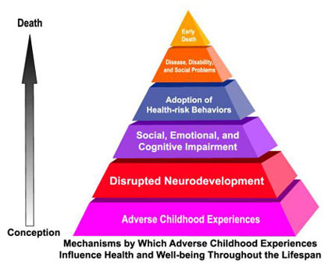
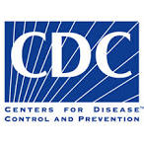
Adverse Childhood Experiences (ACE) Study
Kaiser study
18,000 middle class enrollees
Categories of trauma experienced in childhood such as:
Physical, sexual and verbal abuse
Physical and emotional neglect
Family Member who is
Depressed or diagnosed with other mental illness
Addicted to alcohol or another substance
In prison
Witnessed a mother being abused
Losing a parent due to separation, divorce, or other reason
American Journal of Preventive Medicine 1998; 14:245-258
Information retrieved from Center for Disease Control and Prevention. (2014, May 13)
Notes:
3 minutes
Key point:
Details of the study are as follows....
Voluntary adult participants, while undergoing a standardized physical examination, completed a confidential
survey inquiring about childhood maltreatment and family stressors, as well as current health
status and current behaviors. With this information providing a baseline, the study is continuing
to follow participants over time, in order to determine the relationship between childhood
maltreatment and stressors, on the one hand, and subsequent high-risk behaviors and health
outcomes, on the other.
ALL families experience ACES- first research to open our eyes to how stress, and trauma is significant for ALL families and SF reaches ALL families
*If you would feel more comfortable, play the Ted Talk with Dr. Burke (keep in mind that the video is 15 minutes long)

Slide 4
ACEs are common. About 61% of adults surveyed across 25 states reported they had experienced at least one type of ACE before age 18, and nearly 1 in 6 reported they had experienced four or more types of ACEs.
Preventing ACEs could potentially reduce many health conditions. For example, by preventing ACEs, up to 1.9 million heart disease cases and 21 million depression cases could have been potentially avoided.
Some children are at greater risk than others. Women and several racial/ethnic minority groups were at greater risk for experiencing four or more types of ACEs.
ACEs are costly. The economic and social costs to families, communities, and society totals hundreds of billions of dollars each year. A 10% reduction in ACEs in North America could equate to an annual savings of $56 billion.
From CDC website -- Content source: National Center for Injury Prevention and Control, Division of Violence Prevention

Slide 5
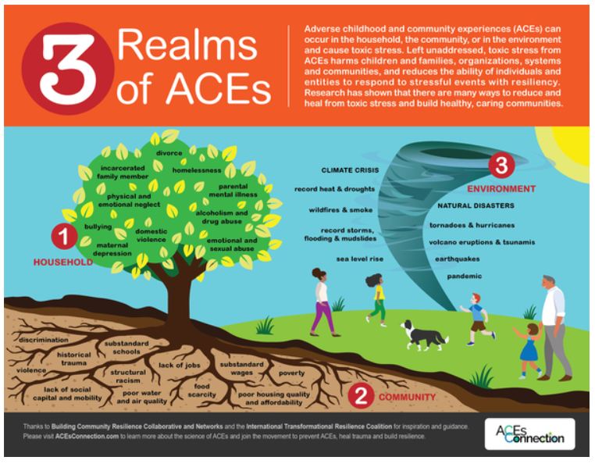

Slide 6
What does it all mean?
Complex Trauma
Toxic Stress and Epigenetics
Stigma
Trauma-Informed Care
Resiliency
Healing
If you have a high ACE score,
are you doomed???

Slide 7
Positive Childhood Experiences Study
(2019)
Surveyed 6000 adults in Wisconsin about mental health in general and asked questions about childhood experiences
Those with 6-7 Positive Childhood Experiences
72% lower risk of depression or poor mental health
Those with 3-5 Positive Childhood Experiences
50% lower risk of depression or poor mental health

Slide 8
Our relational experiences in childhood, whether positive or negative, have lifelong impact.
Can positive relational experiences mediate the impact of ACEs?

Slide 9
The answer is YES!
Adults who self-report more positive childhood experiences (PCEs) have
lower likelihood of clinical depression or poor adult mental health
higher probability of healthy adulthood interpersonal relationships.

Slide 10
“This study offers the hopeful possibility that children and adults can thrive, despite an accumulation of negative childhood experiences.”

Slide 11
7 Positive Childhood Experiences
that occur before the age of 18
Felt able to talk to the family about feelings
Felt the family stood by them during difficult times
Felt safe and protected by an adult in the home
Home & Family

Slide 12
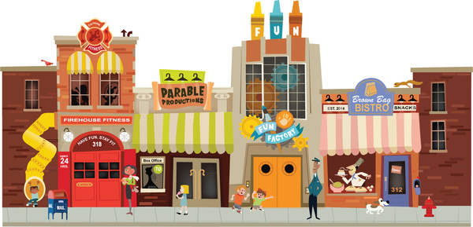
Enjoyed participating in community traditions
Felt a sense of belonging in high school
Felt supported by friends
Had a least 2 nonparent adults who took a genuine interest in them.

Slide 13
Before COVID-19
Some kids had ample opportunities to have many of these experiences at home, school, and in the community
Sports, Prom, Graduation, clubs, et.
Community festivals, parades, fairs, etc.
And, some kids didn’t have these things

Slide 14
NOW (MORE THAN EVER)
WE KNOW
Every moment matters
Every interaction with a young person can change the trajectory caused by ACE’s
We must be deliberate about providing Positive Childhood Experiences (PCEs)

Slide 15
Positive Childhood Experiences (PCEs)
Reframes the dialog
Prioritizes positivity
Solution, healing and engagement oriented
Good mental health is not just the absence of adversity
We are wired to flourish, heal, and grow
Transformational resilience
Optimize whole health and quality of life
“Through Any Door” competencies

Slide 16
“Prioritizing
Possibilities”

Slide 21
Don’t assume that a child is doing fine just because he or she is not showing obvious signs of distress. Check in. Ask the child to share their thoughts, feelings and concerns about what is going on. If the child gives a superficial response like “I’m fine” share some of your own thoughts, feelings and concerns to show that it is acceptable to talk openly about these things.
Listen carefully. Put the electronics down. Give your full attention.
Some children and most teenagers aren’t comfortable maintaining eye contact when talking about their innermost fears and hurts. They’re more likely to bring these things up at times when they don’t have to look directly at you, like when riding in the car. Don’t dismiss the topic because it is not a good time. Make time, even if it means you have to drive extra laps around the block while you do.
Offer compassionate empathy rather than solutions. Many of us are uncomfortable hearing another person’s fears, especially if we don’t know how to fix the situation that is causing them. Showing that the child’s emotions aren’t too frightening for you to handle helps the child to feel safer, less out of control and genuinely connected.
Breathing in the same room is not the same as connecting. Do something together – play a game, do a craft or look at pictures and share memories.
Source: Mary Krietz (Trauma Therapist Program Manager) – Child & Adolescent Behavioral Health

Slide 22
Let the child’s questions guide you. Children will let you know what is on their mind and what concerns them most through the questions they ask. A great way to start a conversation with the child is to ask, “What questions do you have about what is happening?”
As much as possible, keep your traditions and rituals going. This can be elaborate and formal as decorating for and making traditional foods for a holiday. It can be as simple and informal as greeting each other with a certain phrase or making up a secret handshake.
Say the words. Don’t assume they know you care. Every human being needs to hear that he or she is loved. Everyone deserves to hear it when they do a good job. It won’t give them a swelled head if you tell them that you proud of them. It helps them feel connected and appreciated.
Source: Mary Krietz (Trauma Therapist Program Manager) – Child & Adolescent Behavioral Health

Slide 23
Everyone has a role to play in preventing ACEs
& promoting Positive Childhood Experiences
Parents and caregivers
Babysitters
Pediatricians
Friends, family, and neighbors
Coworkers
Everyone
“We support children when we support families
where we live and work .”

Slide 24
What Can We Do
Through Our Work
To Increase
Positive Childhood
Experiences?

Slide 25
Positive Childhood Experiences and Adult Mental Health and Relationships in a Statewide Sample - jamapediatrics_bethell_2019_oi_190057.pdf
PACEs Connection (formerly ACEs Connection) - Home | PACEsConnection
Positive Childhood Experiences (PCEs) - Positive Childhood Experiences (PCEs) - Pinetree Institute
Creating Positive Childhood Experiences - Creating Positive Childhood Experiences | CDC

Slide 26
Positive Childhood Experiences - Ep. 65 - Positive Childhood Experiences – YouTube
HOPE (Healthy Outcomes From Positive Experiences) - Tufts HOPE – Healthy Outcomes from Positive Experiences
Shift the Lens: Think about positive and adverse childhood experiences (A Guide for Pediatric Primary Care Clinicians) - pedaces_unad_cdc_7.15.21.pdf (narcad.org)
Positive Childhood Experiences - Positive Childhood Experiences – Child & Adolescent Behavioral Health (childandadolescent.org)

Slide 27
Amy M. Jeffers, MA, CPS Pathways RPC
Thank you!
Amy.Jeffers@pathways-ky.org

